Slide 1
Capacitors
Dr. Michael Nasief

Slide 2
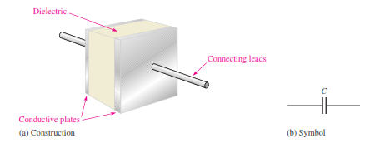
Basic Construction

Slide 3
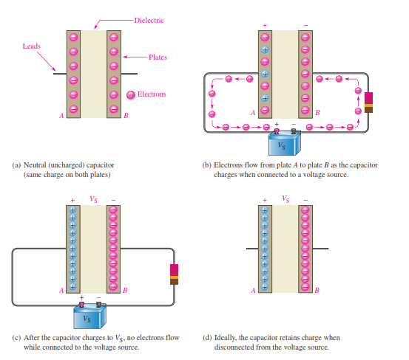
How a Capacitor Stores Charge

Slide 4
Capacitance

Slide 5
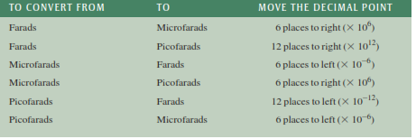
Units

Slide 6
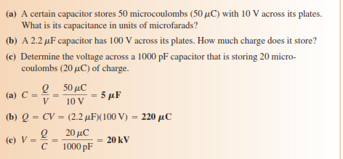
Ex 1

Slide 7
Ex2

Slide 8
EX3

Slide 10
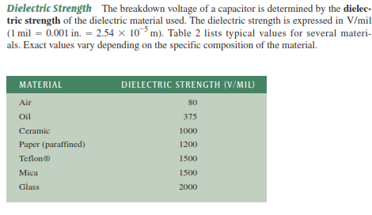
Voltage Rating

Slide 11
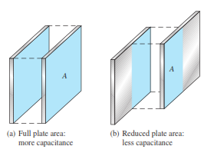
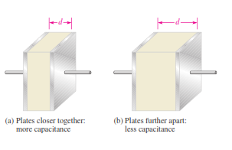
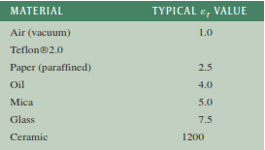
Physical Characteristics of a Capacitor

Slide 12
Ex

Slide 13
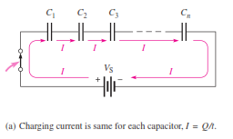
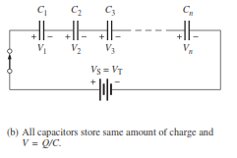
SERIES CAPACITORS

Slide 15
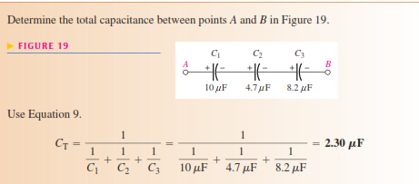
Ex

Slide 16
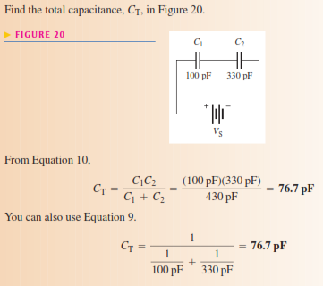
Ex

Slide 17
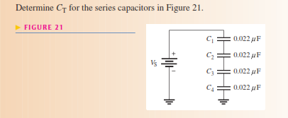
ex

Slide 18
Capacitor Voltages

Slide 19
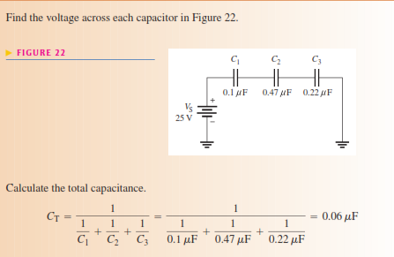
EX

Slide 20
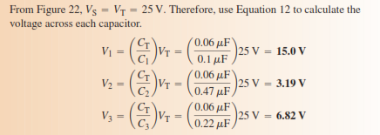

Slide 21
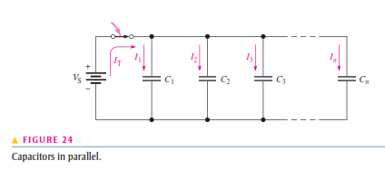
PARALLEL CAPACITORS

Slide 23
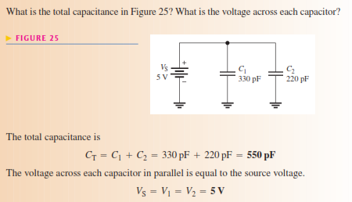
Ex

Slide 24
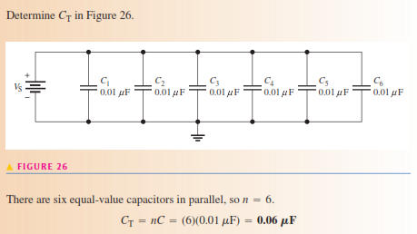
EX

